Slide 1
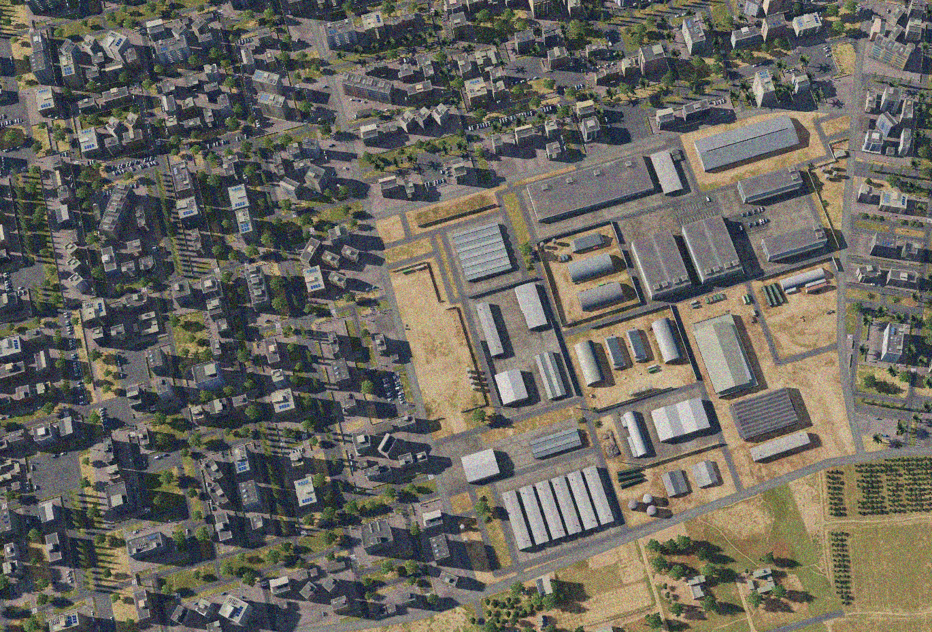

OPARTGT011 RAQQA AMMUNITION FACTORY
N
11
4
2
3
9
1
6
7
8
10
5
11
DESIRED POINT of IMPACT:
DPI 12 - N35 56.310 E 39 00.603 / 781ft / 2000lb PGM
DPI 11 - N35 56.343 E 39 00.580 / 779ft / 2000lb PGM
DPI 10 - N35 56.404 E 39 00.632 / 783ft / 2000lb PGM
DPI 9 - N35 56.439 E 39 00.618 / 778ft / 2000lb PGM
DPI 8 - N35 56.404 E 39 00.583 / 780ft / 2000lb PGM
DPI 7 - N35 56.401 E 39 00.568 / 780ft / 2000lb PGM
DPI 6 - N35 56.395 E 39 00.550 / 779ft / 2000lb PGM
DPI 5 - N35 56.393 E 39 00.536 / 778ft / 2000lb PGM
DPI 4 - N35 56.468 E 39 00.606 / 779ft / 2000lb PGM
DPI 3 - N35 56.453 E 39 00.549 / 775ft / 2000lb PGM
DPI 2 - N35 56.517 E 39 00.483 / 776ft / 2000lb PGM
DPI 1 - N35 56.437 E 39 00.483 / 777ft / 2000lb PGM
12
CDC - High density civilian housing within 20m of facility to the N, E and West.

Slide 2
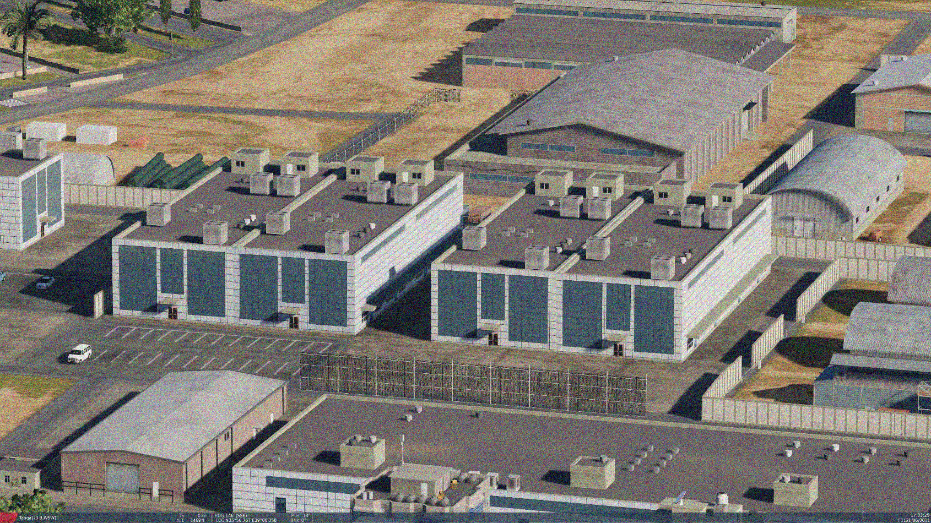
OPARTGT011 RAQQA AMMUNITION FACTORY
Known to be producing a-g rockets which includes MSLR artillery rockets.
The facility is embedded within a highly dense civilian population and thus poses significant CDC.
The assembly buildings are made of reinforced concrete which require at least a 2000lb bomb.
N
11
8
7
6
5
3
2
1
CDC - High density civilian housing within 20m of facility to the N, E and South. Approx 100m to the West. Chemical precursors within complex (in red) pose high risk of pollution to civilian population if destroyed.

